Slide 1
Surface Water Impact on Groundwater in Coastal Rhode Island
Shahriar Bin Shahid Ph.D. Student Department of Geosciences

Slide 2
Background of the Study
1. Geographic Characteristics (Barlow and Reichard, 2010):
- Low lying topography
- Sea-side location
- North American coast
2. Suitable Study Area:
- Rhode Island is situated along the Northeastern coast.
3. Availability of Data Sources:
- Remote sensing tools
- Hydrological data
4. Significant Factors:
- Interaction with wastewater systems
- Contaminant transport
- Saltwater intrusion
- Nutrient flow
- Ecological dynamics

Slide 3
Project Goal
1. Proposal Idea:
- Investigate the correlation between surface water variability and groundwater table levels along the Rhode Island coast using remote sensing techniques.
2. Research Question:
- How does the fluctuation of coastal water levels influence the groundwater table in Rhode Island?
3. Goals Achieved:
- Achieved a preliminary understanding of surface and groundwater interaction along the Rhode Island coast.
- Developed insights while analyzing remote sensing tools (Digital Elevation Model), and hydrological information.
- Correlating depth and elevation information provided preliminary findings for the entire state of Rhode Island.
- Identified future research directions for a more comprehensive analysis.

Slide 4
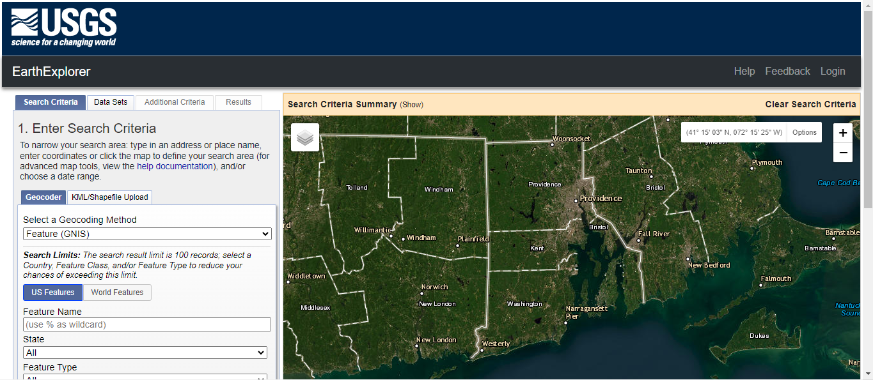

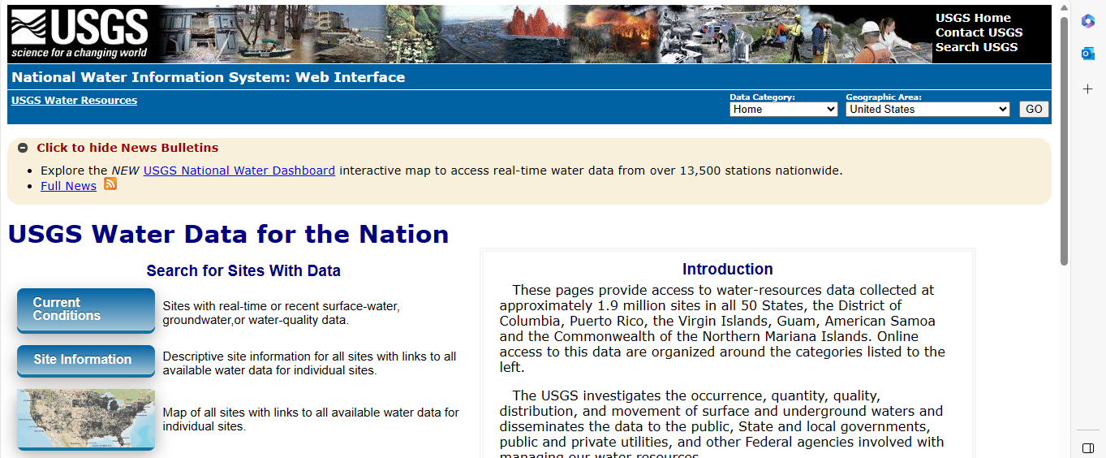
Methodology
Datasets:
Surface water and groundwater data source: USGS National Water Information System (https://waterdata.usgs.gov/nwis)
Digital Elevation Model source: USGS EarthExplorer (https://earthexplorer.usgs.gov/)
Pond Depth data source: State of Rhode Island, Department of Environmental Management (https://dem.ri.gov/)
Computing Environment: Jupyter Notebook
Figure: USGS EarthExplorer Website
Figure: RIDEM Website
Figure: USGS Waterdata Website

Slide 5
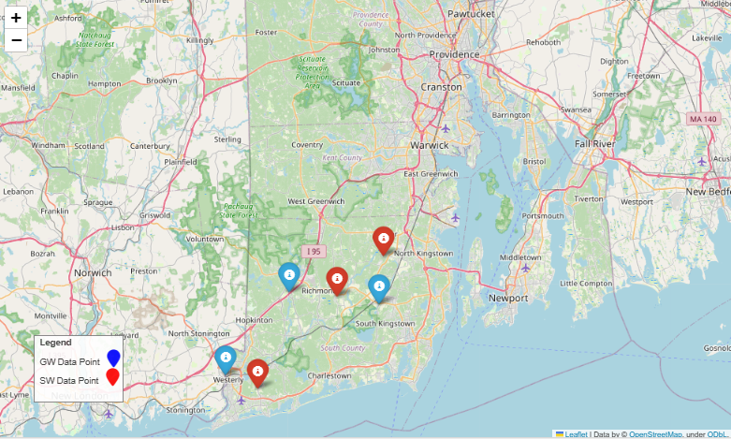
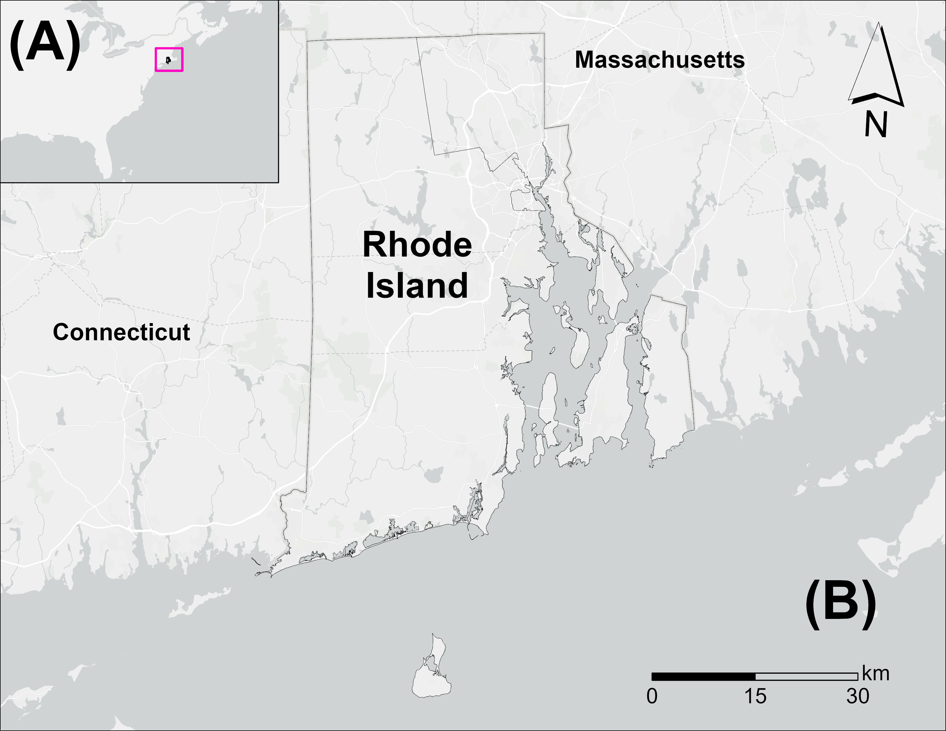
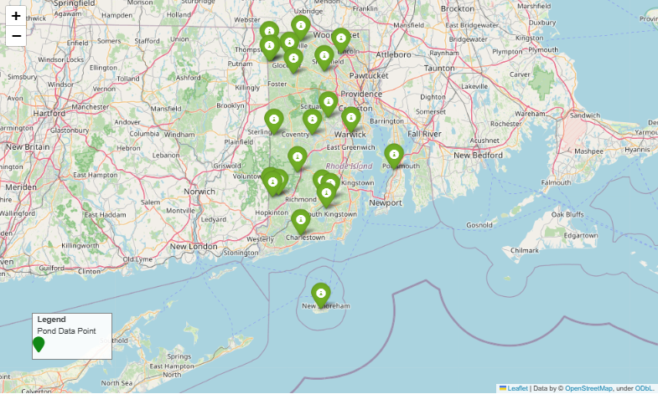
Study Area
Figure: Location of measured water levels.
Figure: Location of the study area.
Figure: Location of ponds.

Slide 6
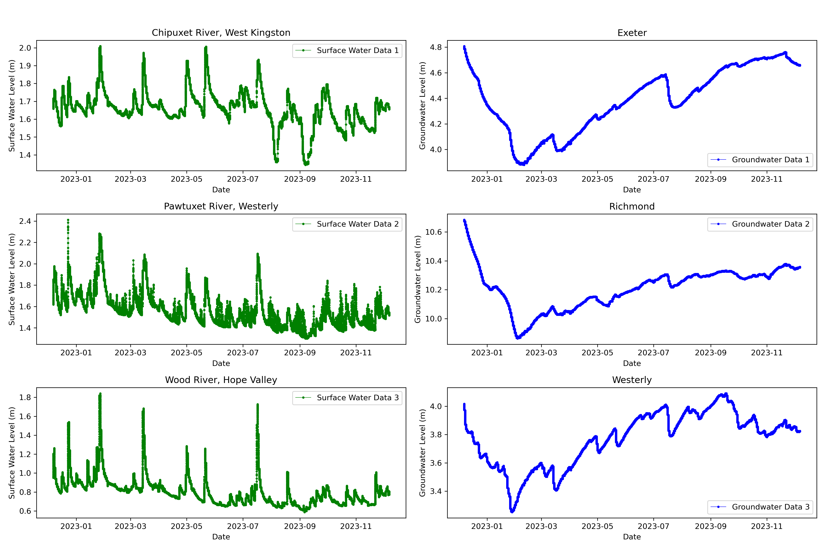
Result: Time Series
Figure: Groundwater and surface water level time series graphs showing variations in the water table from December 2022 to December 2023.

Slide 7
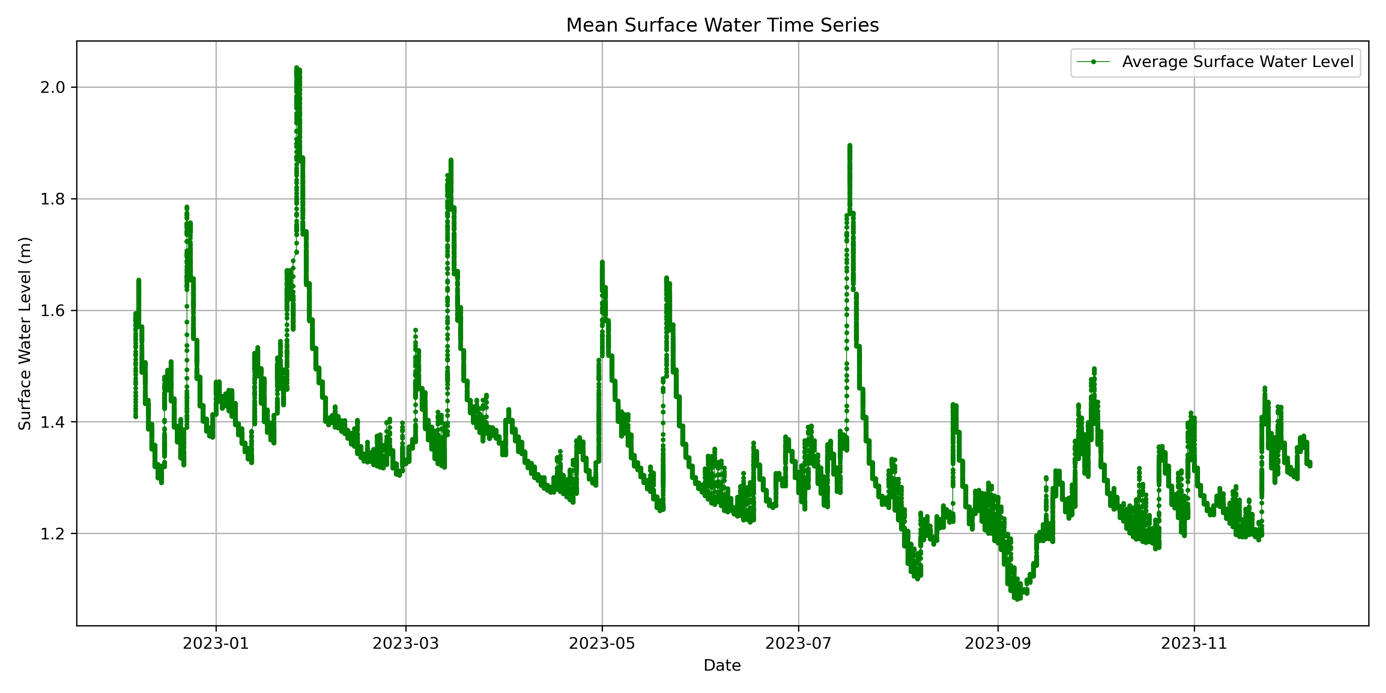
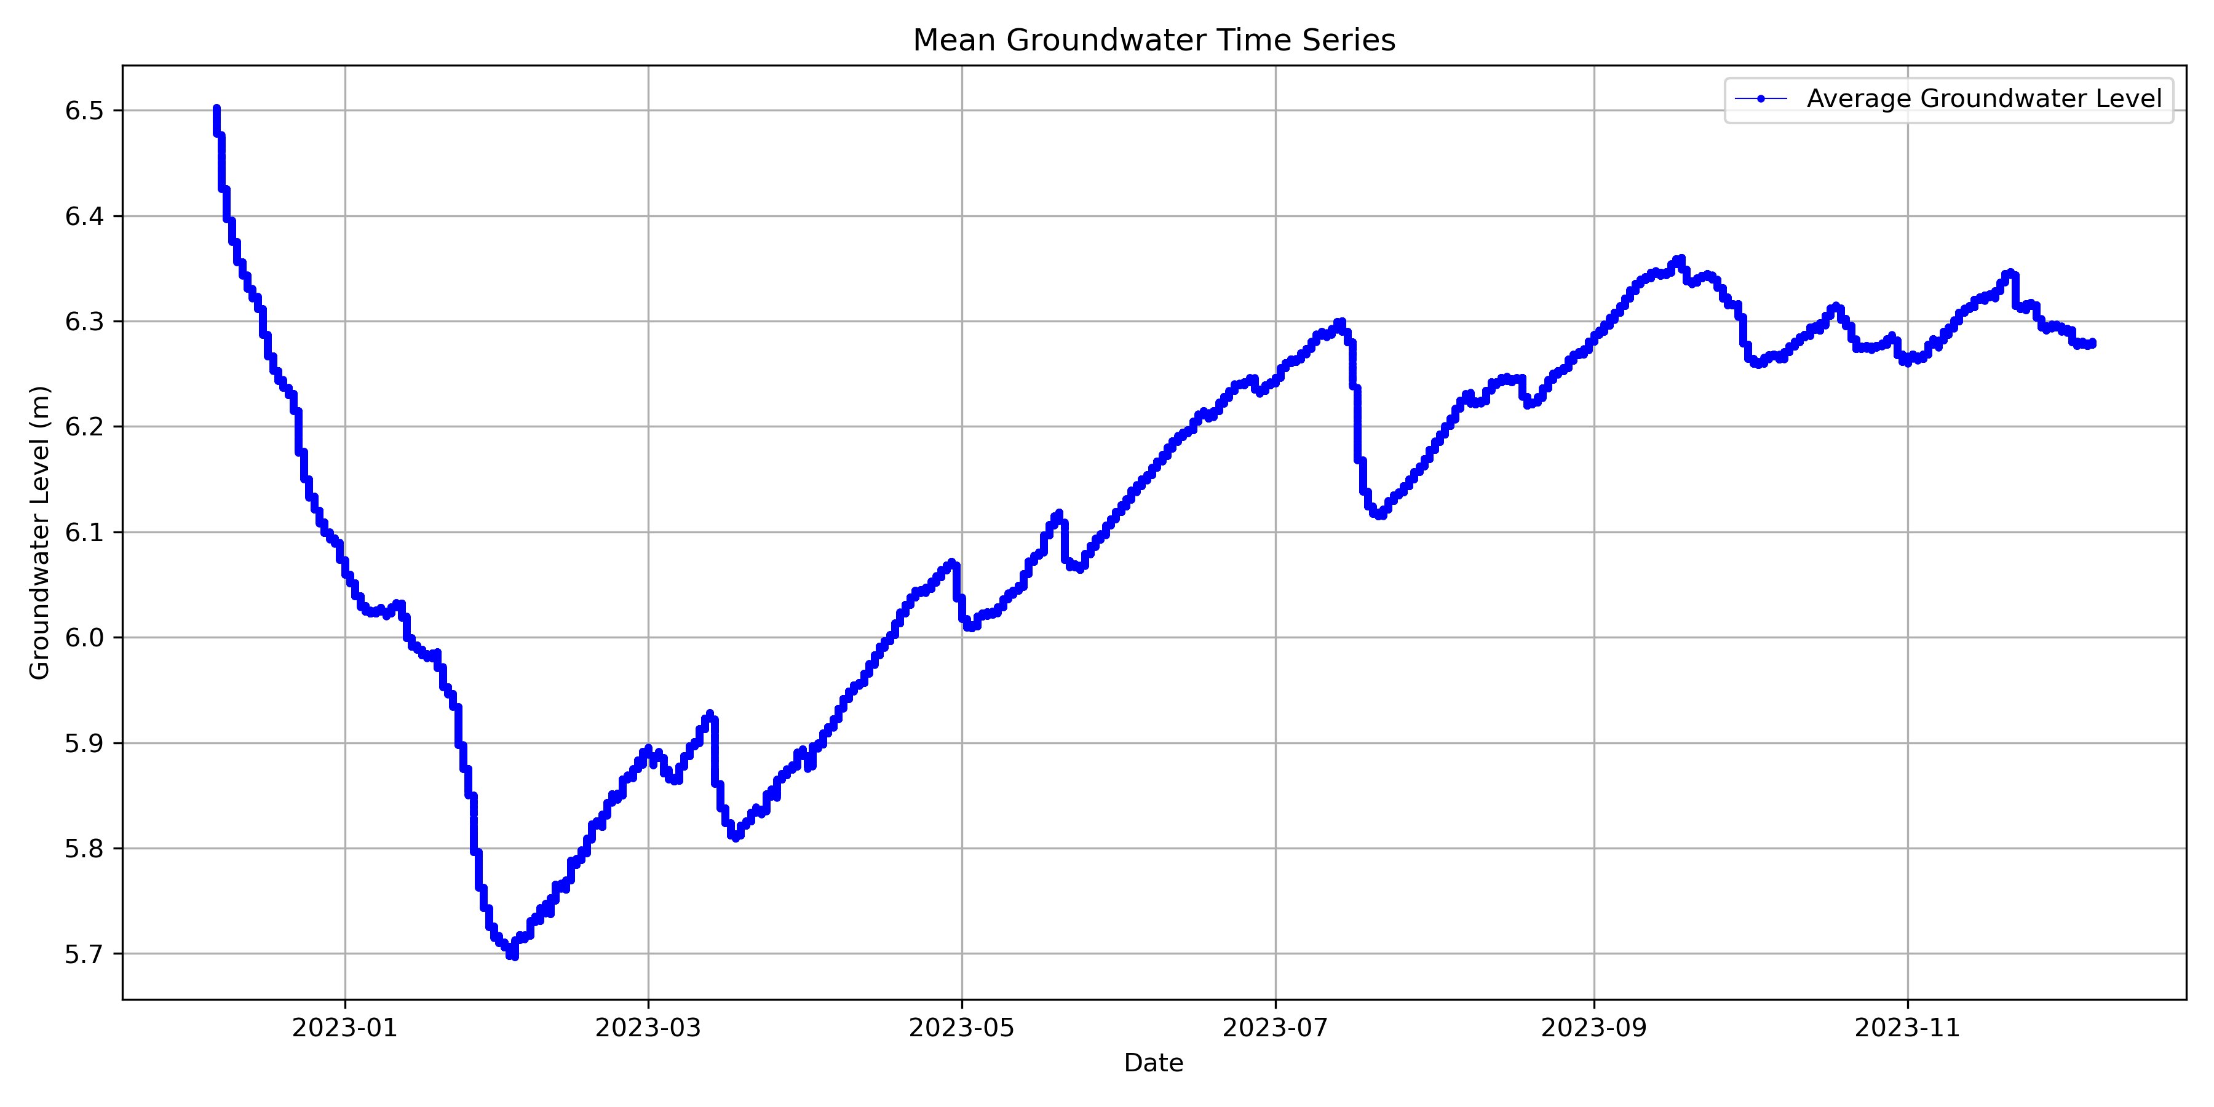
Result: Average Time Series
Figure: Average surface water level time series
(December 2022 to December 2023) for three
study sites in Rhode Island.
Figure: Average groundwater level time series
(December 2022 to December 2023) for three
study sites in Rhode Island.

Slide 8
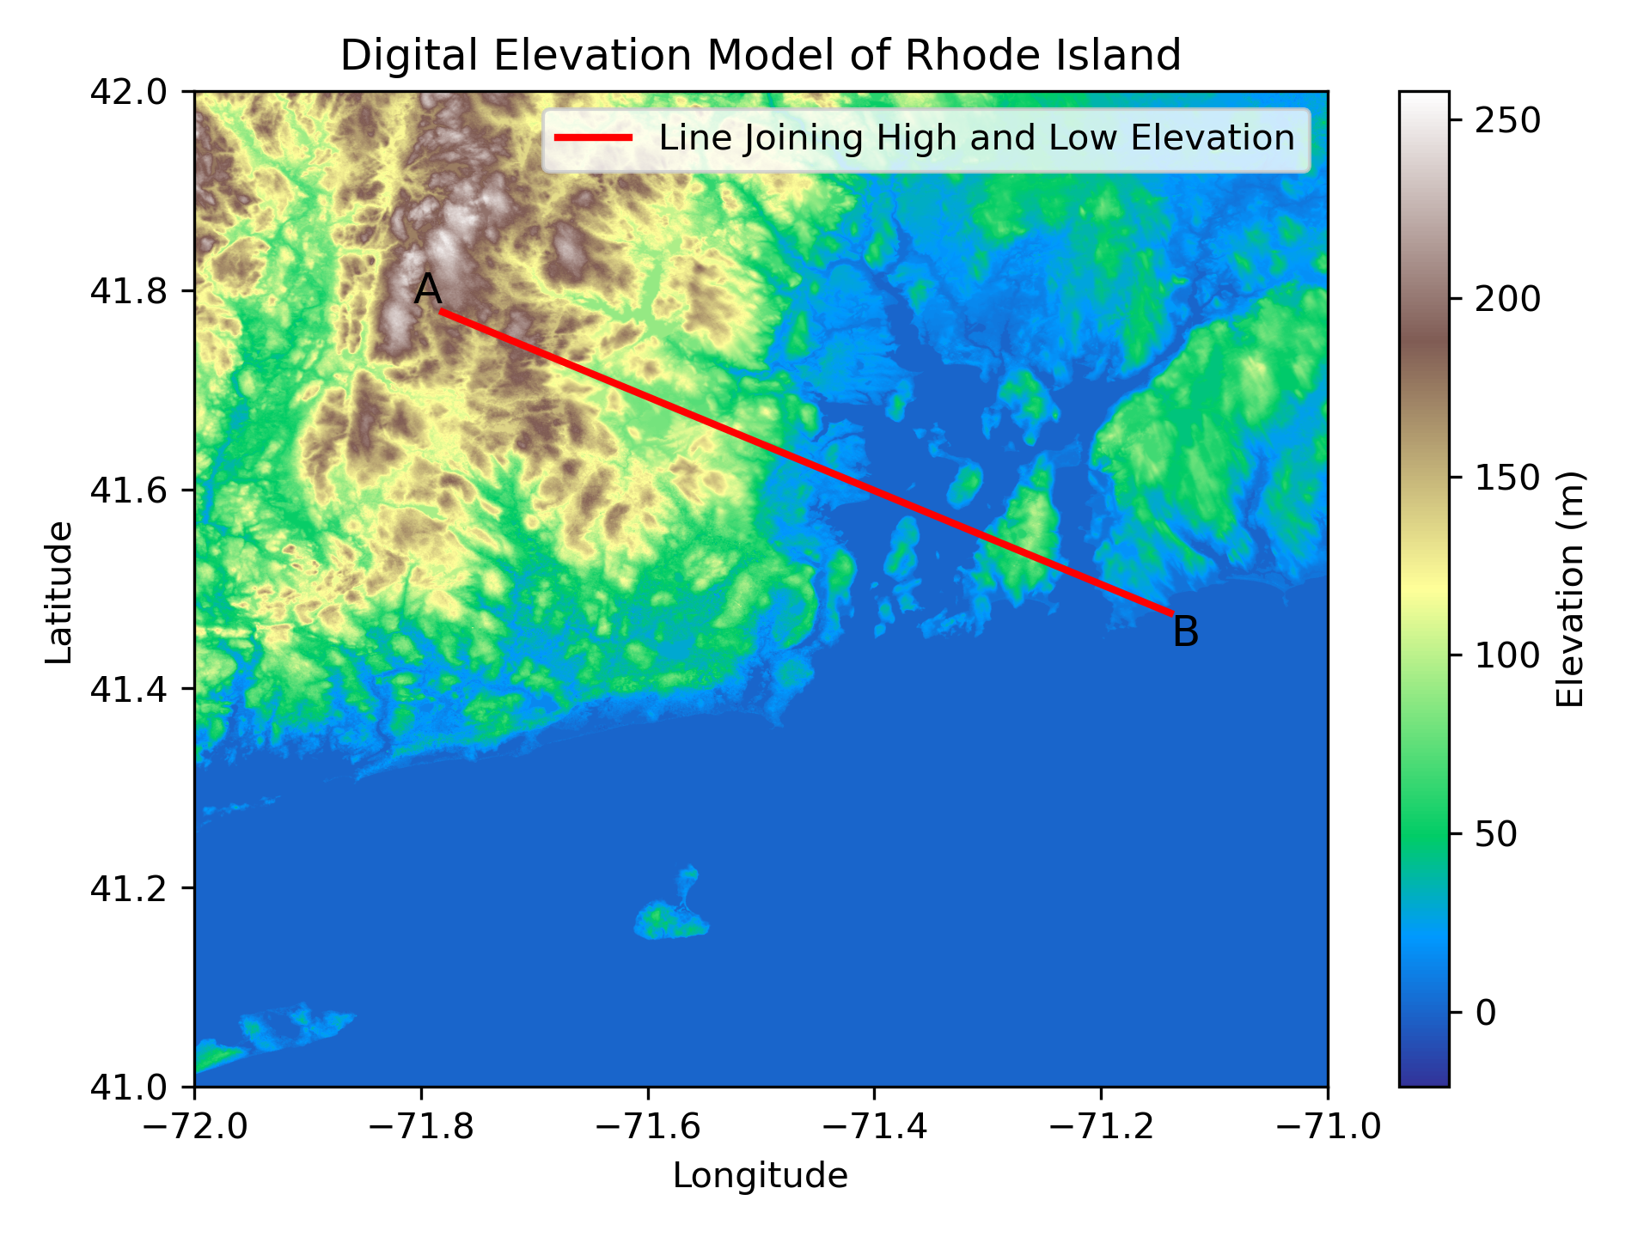
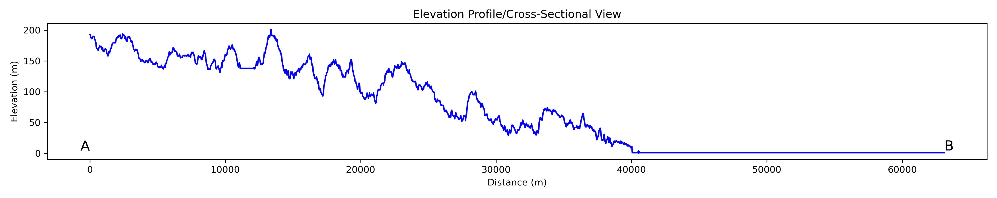
Result: Elevation Profile
Elevation gradually decreases from inland towards the coast.
The highest elevation is around 250 m.
Figure: Illustrating the overall elevation trend from inland towards coastal Rhode Island based on the Digital Elevation Model
(Data courtesy: USGS EarthExplorer).

Slide 9
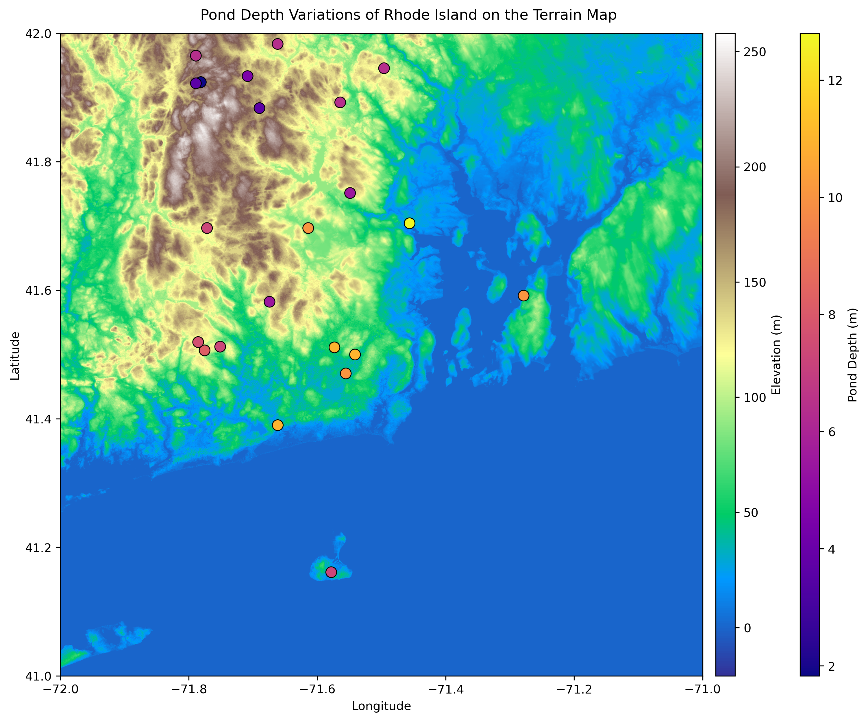
Result: Pond Depth Variations
Colored dots indicate pond locations.
Different colors represent varying depths.
Highly elevated areas are mostly inland.
Lighter-colored dots (yellowish) suggest higher depths.
Darker-colored dots (bluish) suggest lower depths.
Figure: Illustrating the variations in maximum pond depth with different elevations.

Slide 10
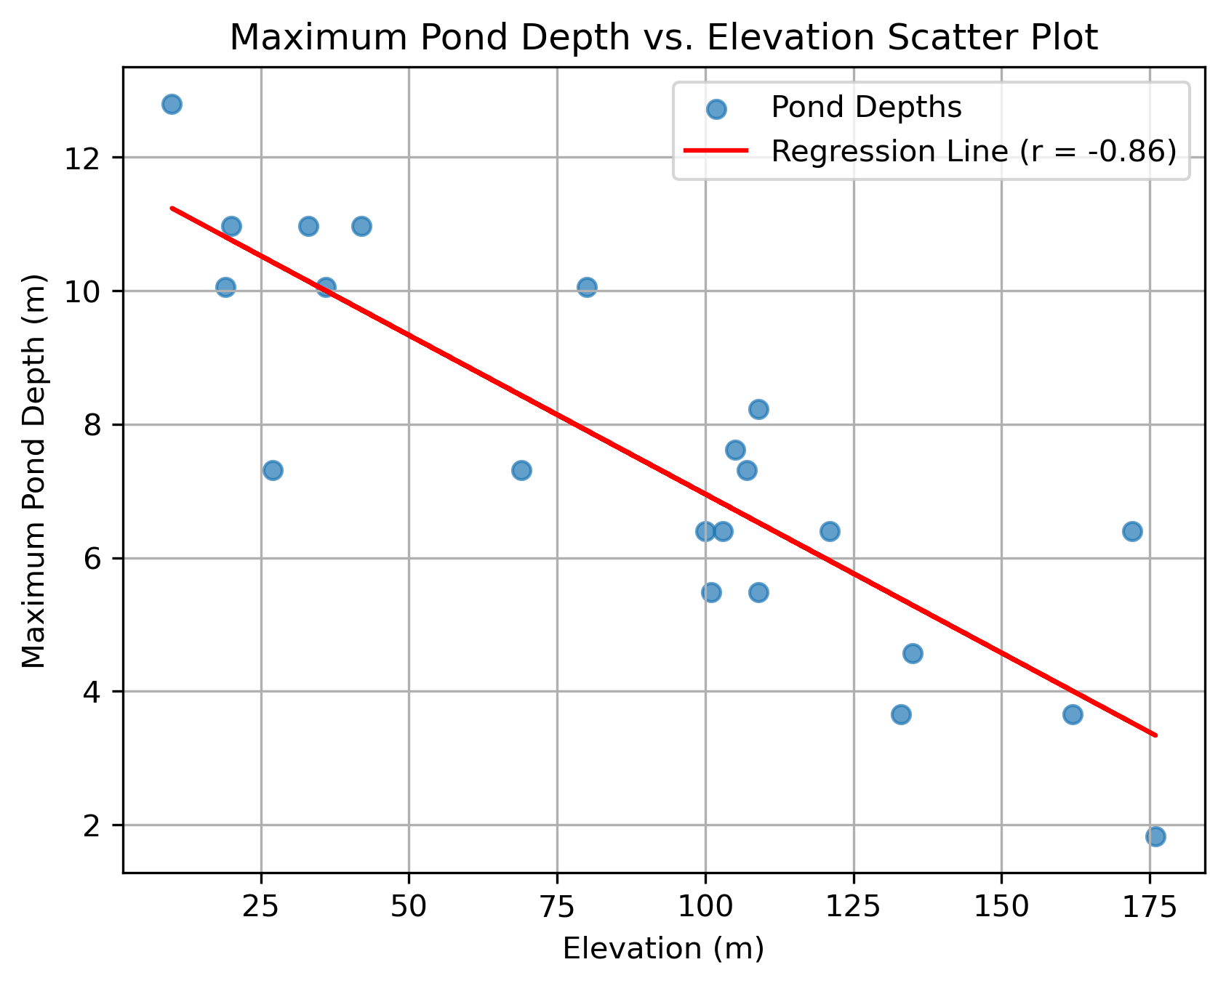
Result: Pond Depth vs DEM Scatter Plot
The depths of 22 ponds were considered.
Maximum pond water depths ranged between 1.8 m and 12.8 m.
The correlation coefficient of -0.86 shows a strong negative correlation between depth and elevation.
Highly elevated areas have shallower ponds.
Figure: Scatter plot of maximum pond depth against elevation shows a strong negative correlation coefficient.

Slide 11
Discussion
Stable surface (1.1-2m) and groundwater levels (5.7-6.5m).
Can indicate a balance between inflows and outflows.
Deeper coastal ponds can impact groundwater, coupled with tidal dynamics and seawater intrusion.
Precipitation, recharge, and land use may have more significant impacts on groundwater compared to shallower ponds.
Future Directions
A more comprehensive hydrological study is needed.
Factors such as precipitation, surface water runoff, groundwater withdrawals, flow directions, and recharge patterns can be considered.
More information on ponds, lakes, or lagoons will provide more accurate insights.

Slide 12
Reference
Barlow, P.M. and Reichard, E.G., 2010. Saltwater intrusion in coastal regions of North America. Hydrogeology Journal, 18(1), p.247.

